Slide 1

ChadaTech SNHU Travel Project Scrum-Agile Approach Cole Schafer

Slide 2
Scrum-Agile Team Roles
Product Owner
Aligns scrum team with overall product goals
Manage product backlog by ordering work by priority
Communicate with others outside the Scrum Team
Scrum Master
Makes sure the Scrum Team is working as effectively as possible
Facilitate daily Scrum Meetings
Lead sprint planning meetings
Help solve any impediments that the developers may have
Development Team
Completes the tasks of the Scrum sprint
Collaborate with others to plan goals and plans to achieve them
Help in sprint planning
Write code
Program, design, or improve products
Test products

Slide 3
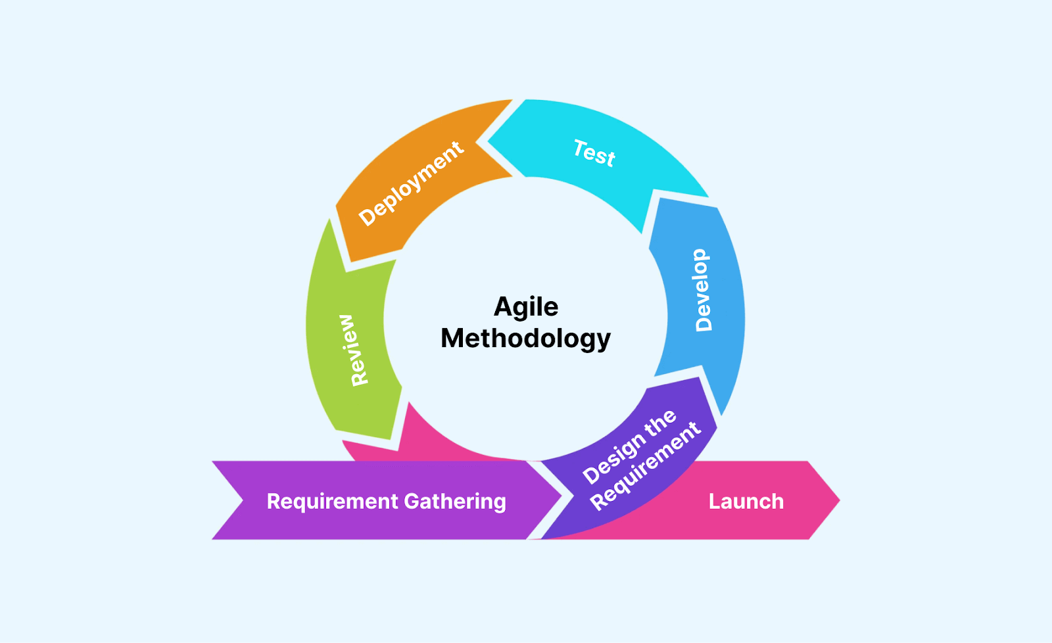
SDLC Phases in an Agile Approach
Requirement Gathering: define criteria, estimate time and effort, evaluate technical and economic feasibility
Design the Requirement: collaboration with stakeholders to define project requirements
Develop: designers and developers begin working on the project.
Multiple development stages occur before the application gets deployed.
Test: test the application to ensure the software performs as intended and identify bugs
Deployment: product/application is released
Review: the team gathers feedback and addresses any concerns/fixes bugs

Slide 4
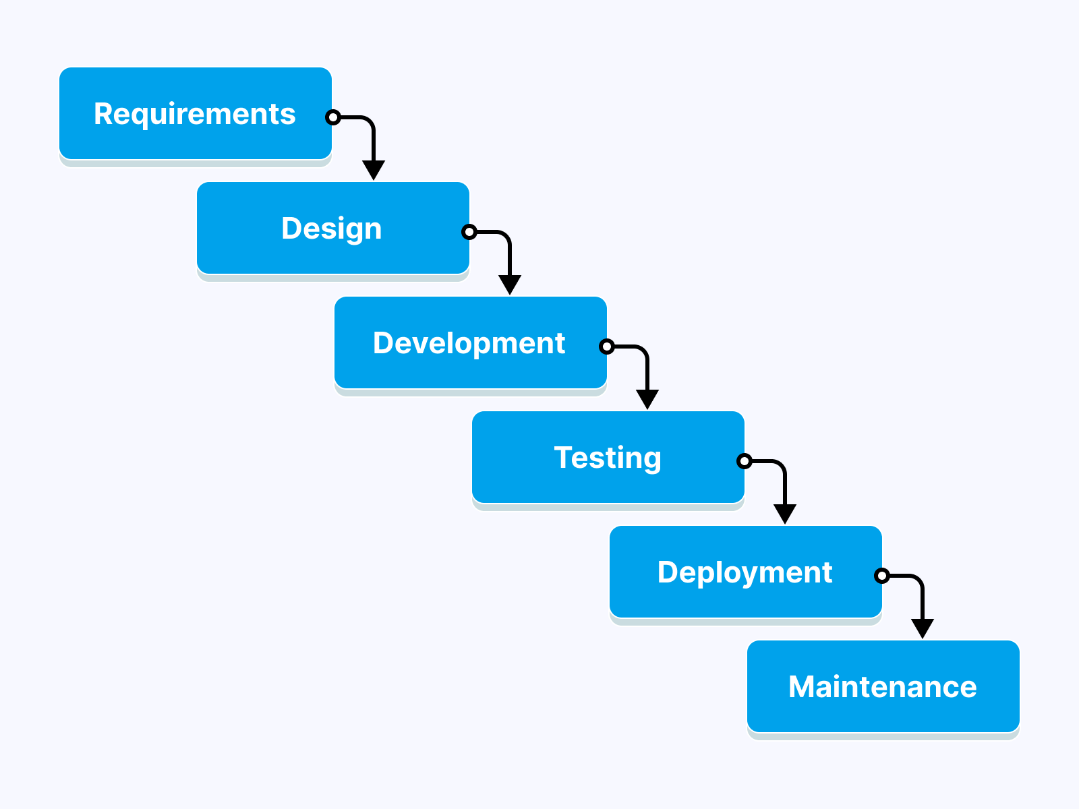
Waterfall Model
In the Waterfall Model, each stage is completed before proceeding to the next stage. This model is linear and non-flexible. There is no returning to the previous phase to make changes in the waterfall model.
The Waterfall Model would not have worked well during the SNHU Travel Application Project. In the middle of the project, SNHU Travel had changes they wanted implemented. These changes couldn’t have happened with a waterfall approach because the planning, design, and development were already completed or being worked on.

Slide 5
Waterfall vs Agile Approach
Waterfall model
Agile approach
Works well when the requirements are clear, fixed, and unlikely to change
Linear model
Delivers work at once
Team roles are more defined
Greater risk if requirements change and testing at end
Works best if the requirements are expected to evolve or initially unclear
Revisit phases during each sprint
Delivers work in each sprint
Team roles are cross-fuctional
Reduced risk by allowing changes and early/frequent testing

Slide 6
References
Staff, C. (2024). The 3 Scrum Roles and Responsibilities Explained. Coursera. https://www.coursera.org/articles/scrum-roles-and-responsibilities?msockid=224e79a0bcb06b1f39e06ad8bd636ab7
Overeem, B. (2016, April 15). Characteristics of a Great Scrum Team. InfoQ. https://www.infoq.com/articles/great-scrum-team/
5 Most Popular Types of SDLC Models. (2024, February 12). LambdaTest. https://www.lambdatest.com/blog/sdlc-models/
‌Software Development Life Cycle (SDLC): A Comprehensive Guide With Best Practices. (n.d.). Www.lambdatest.com. https://www.lambdatest.com/learning-hub/software-development-life-cycle

